Slide 1

Software configuration management
Empire Hotel: Online reservation system
For lecturer nurul sharaz binti azmanuddin
Muhammad Faid Luqman Bin Nor Hasni, 52213218086
Syifa’Ul Husna Binti Halim, 52213218074
Faizah Chaibou Issoufou, 52213218138

Slide 2

Project Background
System Scope
EmpireHotel
Online Hotel Reservation System
Developed in 2015
via PHP and MySQL
View hotel information
Make a reservation
Manage reservation, gallery and room information
Check transaction
Print Reservation Details

Slide 3

System Objectives
To provide 24 hours online reservation service.
To speed up the reservation process.
To maximize productivity and sales.
To provide flexibility to the customer
To manage the reservation efficiently.
To reduce the manual workload
To advertise hotel via online

Slide 4

Rebrand and enhance the outdated online system
Fix the current bugs
Along with additional feature
Current
Project Purpose

Slide 5
Project Cost
No | Software Name | Description | Cost (RM)
1 | Microsoft Office Professional Plus 2019 | For managing documentation and presentation | RM 2,399
2 | Microsoft Project 2019 | For creation of Gantt Chart | RM 2,899
3 | Microsoft Visio 2019 | For creation of UML Diagram | RM 2,899
4 | Adobe Illustrator CC 2019 | For creation of necessity 2D vector graphics | RM 1,130.43
5 | Google Chrome | For browsing and downloading files | Freeware
6 | MySQL & PHP | Database management tool/system to manage data | Freeware
TOTAL COST (Software) |  |  | RM 9,327
No | Hardware Name | Description | Cost (RM)
1 | 3 Laptop GX503 | This is the main devices that is use develop the mobile app | RM 3,500 x 3 = RM10,500
3 | HP LaserJet Pro M15w Printer | This printer device is use to print all of the necessary papers including AR marked paper. | RM 399
Other Requirements
5 | Unifi 100mbps | Internet is used for development | RM129 per month = RM 774
6 | Electricity & Water | Usage of electric and water | RM400 per month = RM 2400
TOTAL COST (Hardware & Book) |  |  | RM 11,673
No | Human Resources Name | Cost (RM)
1 | Project Manager | RM 7,000
2 | Web Developer & Web Designer | RM 5,000
3 | System Analyst & Tester | RM 5,000
Total Cost (Human Resources) |  | RM 23,000 x 6 Months = RM102,000
TOTAL COST (RM) include all | RM 123,000

Slide 6

New Expected Version
Due-date: 3 October 2020 Date Completed: 3 October 2020
CR1 - D: Revamp print button (4 days duration) CR2 - N: Add search capabilities for admin (7 days duration) CR3 - N: Add more bank type option (4 days duration) CR4 - N: Add message box for additional information and request of reservation (5 days duration) CR5 - E: Refine payment approach (3 days duration) CR6 - E: Refine website design (30 days duration) CR7 - N: Add validation for room selection when reserving room (6 days duration) CR8 - N: Add Login for customer (15 days duration) CR9 - N: Add Register for customer (20 days duration) CR10 - N: Add Logout for customer (2 days duration) CR11 - N: Add reservation history (6 days duration) CR12 - N: Add status confirmation for Admin (Cancel, Confirm, Complete Booking) (5 days duration) CR13 - N: Add room cancellation (5 days duration) CR14 - E: Refine navigation bar in term of its button (3 days duration) CR15 - N: Add manage bank accounts for admin (6 days duration) CR16 - N: Add validation for kogin and register (10 days duration)

Slide 7
Old Process Flow (Customer)

Slide 8
New Process Flow (Customer)

Slide 9
Old Process Flow (Admin)

Slide 10
New Process Flow (Admin)

Slide 11

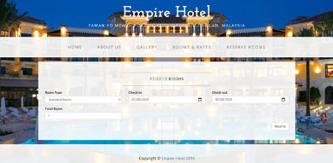
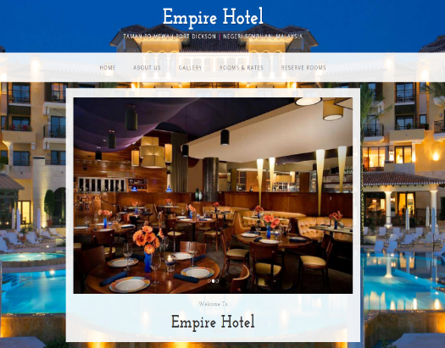
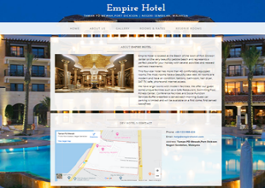
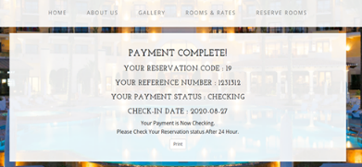
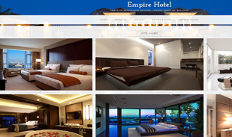
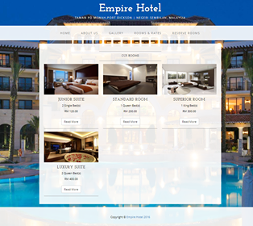

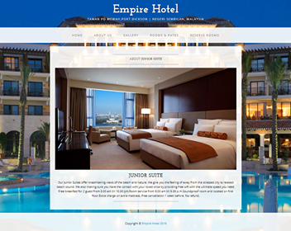
CR #6
(Website Design)

Slide 12
CR #8, CR #9, CR #10, CR #14 and CR #16
No Login, Logout, Register and their validation
Login and Register need to be added as button in navigation bar

Slide 13
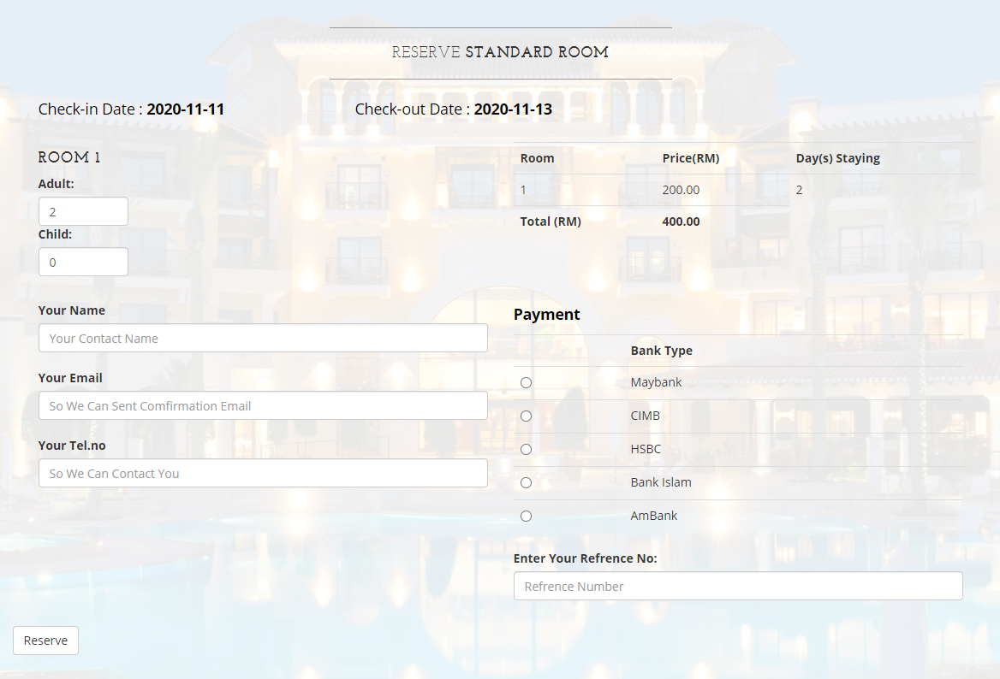
CR #3, CR #4 and CR #7
(Limited bank options, no message box for special request and no validation for reservation form)

Slide 14
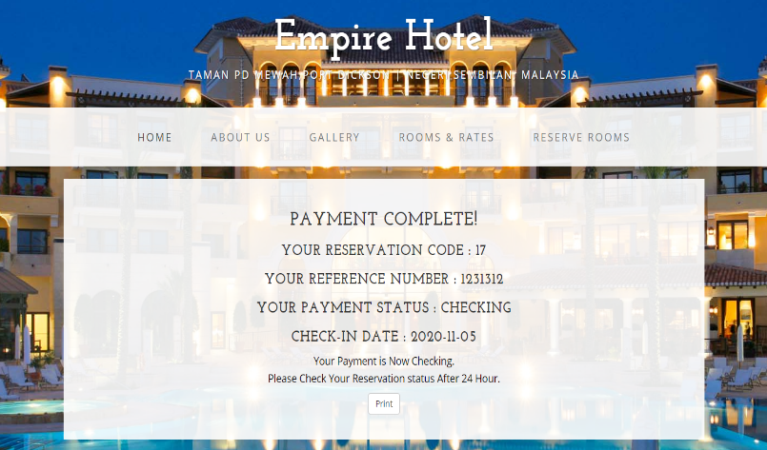
CR #1
(Print button not working/obsolete)

Slide 15
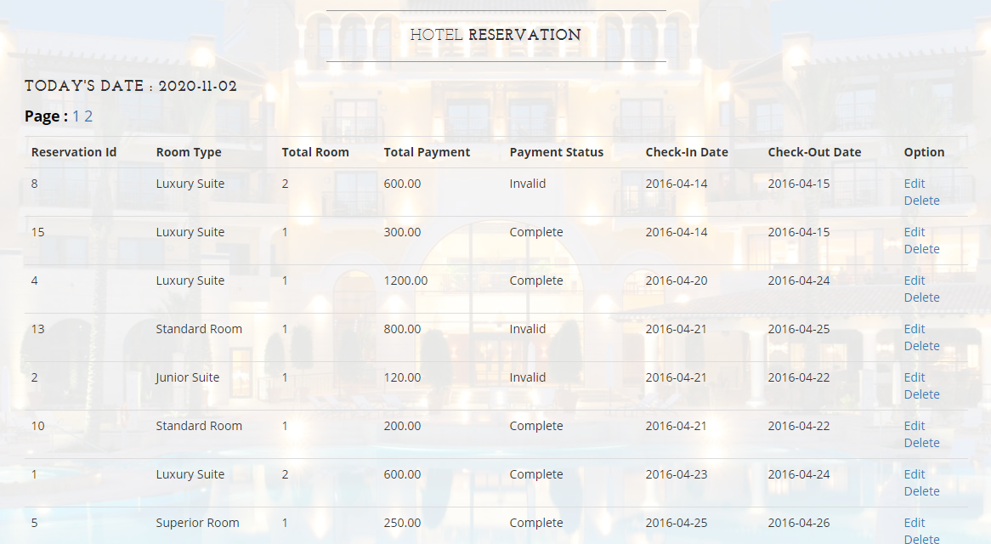
CR #2
(No searching capabilities – manual search relied on paging number)

Slide 16
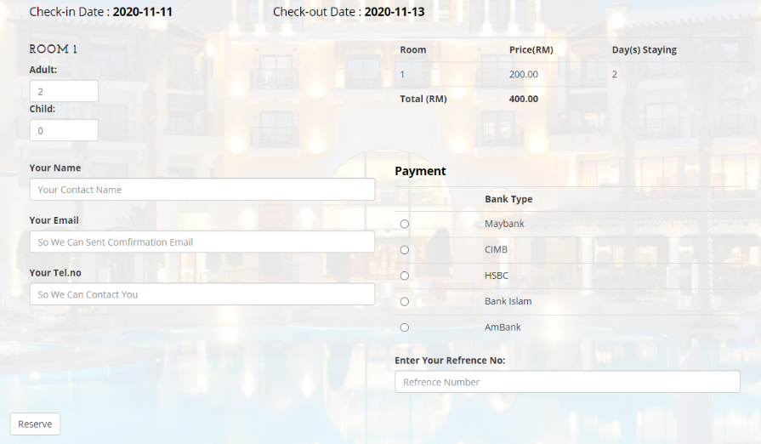
CR #5
(Outdated Payment Process – Can’t pay on website)

Slide 17
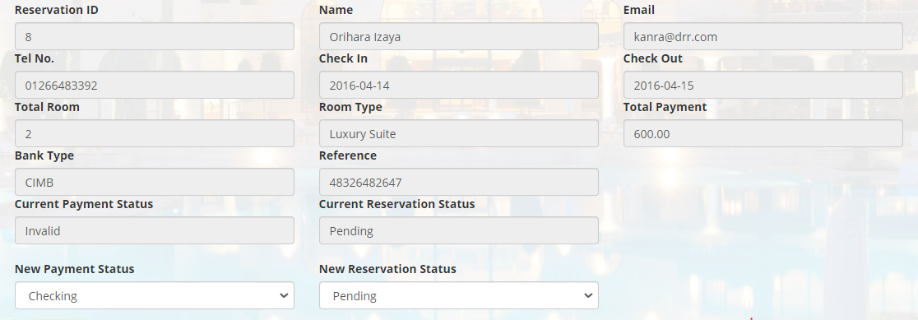
CR #11
(No reservation history feature for customer to check for past transaction)
CR #13
(No room cancellation feature for customer to cancel reservation)
Admin Side only

Slide 18
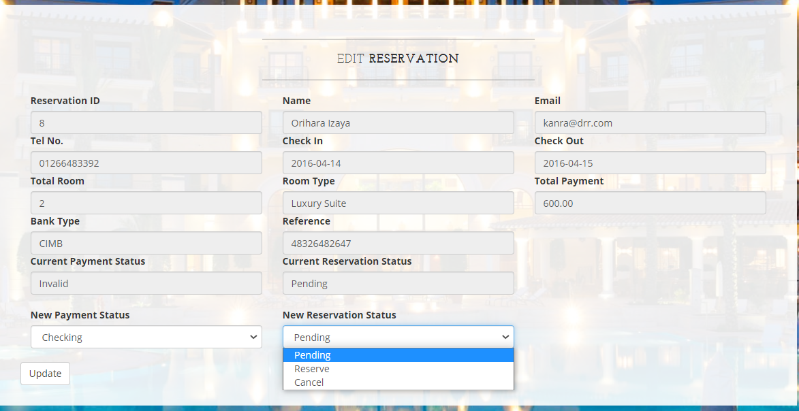
CR #12
(Add and Refine Reservation Status)
Admin Side only

Slide 19
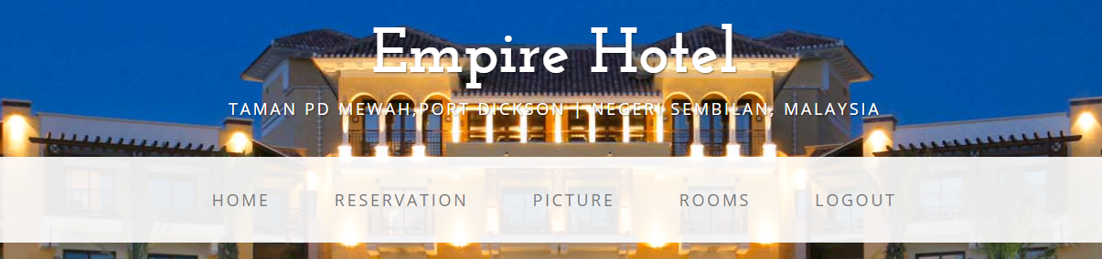
CR #15
(No manage bank option to add, update and delete bank)
Admin Side only

Slide 20

New Website (Video Demo)

Slide 21
GitHub (Video Demo)

Slide 22
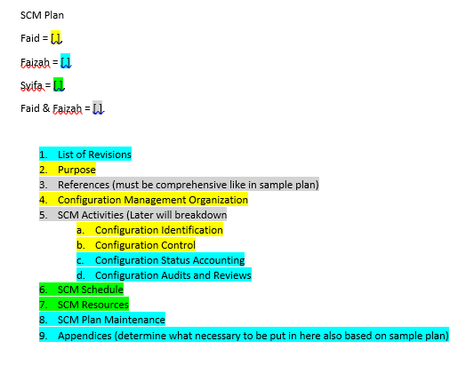
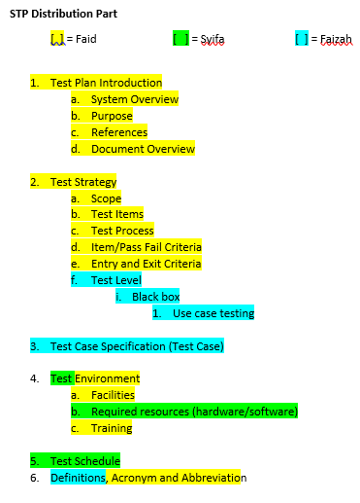
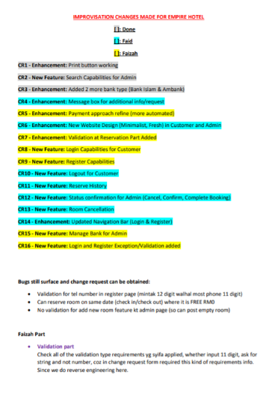
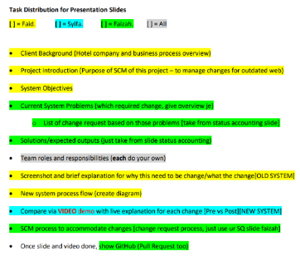
Task distribution documents created and assigned by Faid
Overall the members did excellent works based on their expertise.
[ ] Syifa - did all the coding part

Slide 23
Muhammad Faid Luqman Bin Nor Hasni (Project Manager)
Roles, Responsibilities and Tasks
Consist of
Assign and distribute all work tasks in project systematically and equally according to their expertise.
Create a guidelines and distribution document for all works
Plan the schedule to complete task
Write SCM Plan part:
Introduction (Document Overview, Purpose, Acronyms, References)
Organization
Configuration Identification
Configuration Control
Write STP Plan part:
Test Plan Introduction (System Overview, Purpose, References, Document Overview)
Test Strategy
(scope, test items, test process, item/pass fail criteria, exit/entry criteria)
Test Environment
(Facilities and Training)
Acronym and Abbreviation
Review all the work that each team member do for SCM plan, Change Request, GitHub and especially Web Prototype. I will approve or demand revision.
Amend some part up to my standards.
Also add 8 Change Request and amend 1 Minutes of Meeting up to my standards.
Manage Github
along with Faizah
Create some announcement post.
Facilitate few branch
Do Status Accounting Slide
Check and Reply post in GitHub
Proposal (Assignment 1)
Compile all documentation

Slide 24

Name | Faizah Chaibou Issoufou
Role | Configuration Manager
Task done | Minutes of meeting CR form Submit CR on GitHub SCM plan Review and check SCM plan Proposal (ASSG1) | 3 minutes 8 CR form 17 submissions List of revisions, References, Definitions, Status accounting, SCM maintenance, Appendices
Task to do | STP
Rating | 5/5

Slide 25
Name | Role | Task Done | Task To Do | Rating
Syifa’Ul Husna Binti Halim | Developer | -Fixing and upgrading system based on CR (All programming work) -SCM project proposal -Creating GitHub repository information -SCM Plan resource and schedule -Week 7 status accounting -Proposal (ASSG1) | -STP - Update GitHub on project progress regularly -SCM Plan | 5/5

